Slide 1










Duplication
Coloring Book
@Llewellyn Falco

Slide 2
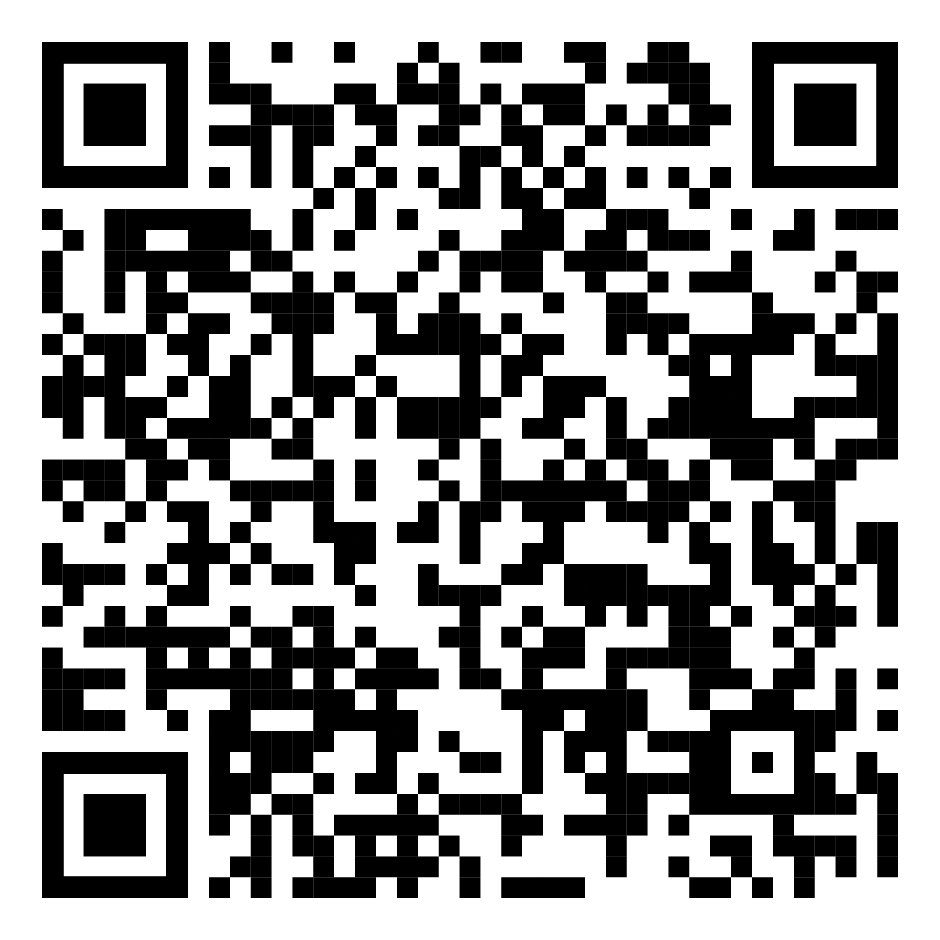
https://github.com/isidore/Talks/blob/master/DuplicationColoringBook.md#duplication-coloring-book

Slide 3
Outline
Training Patterns
Recipe For Removal
Do Process
Sparrow Decks
Coloring
Code

Slide 4
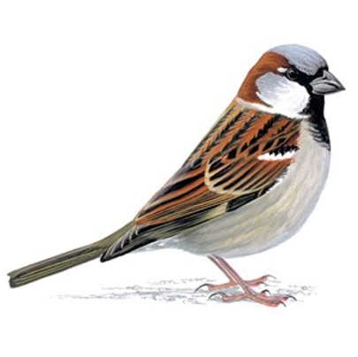
Step 1
Pattern
Training

Slide 5

Rules:
Say it aloud Try

Slide 6
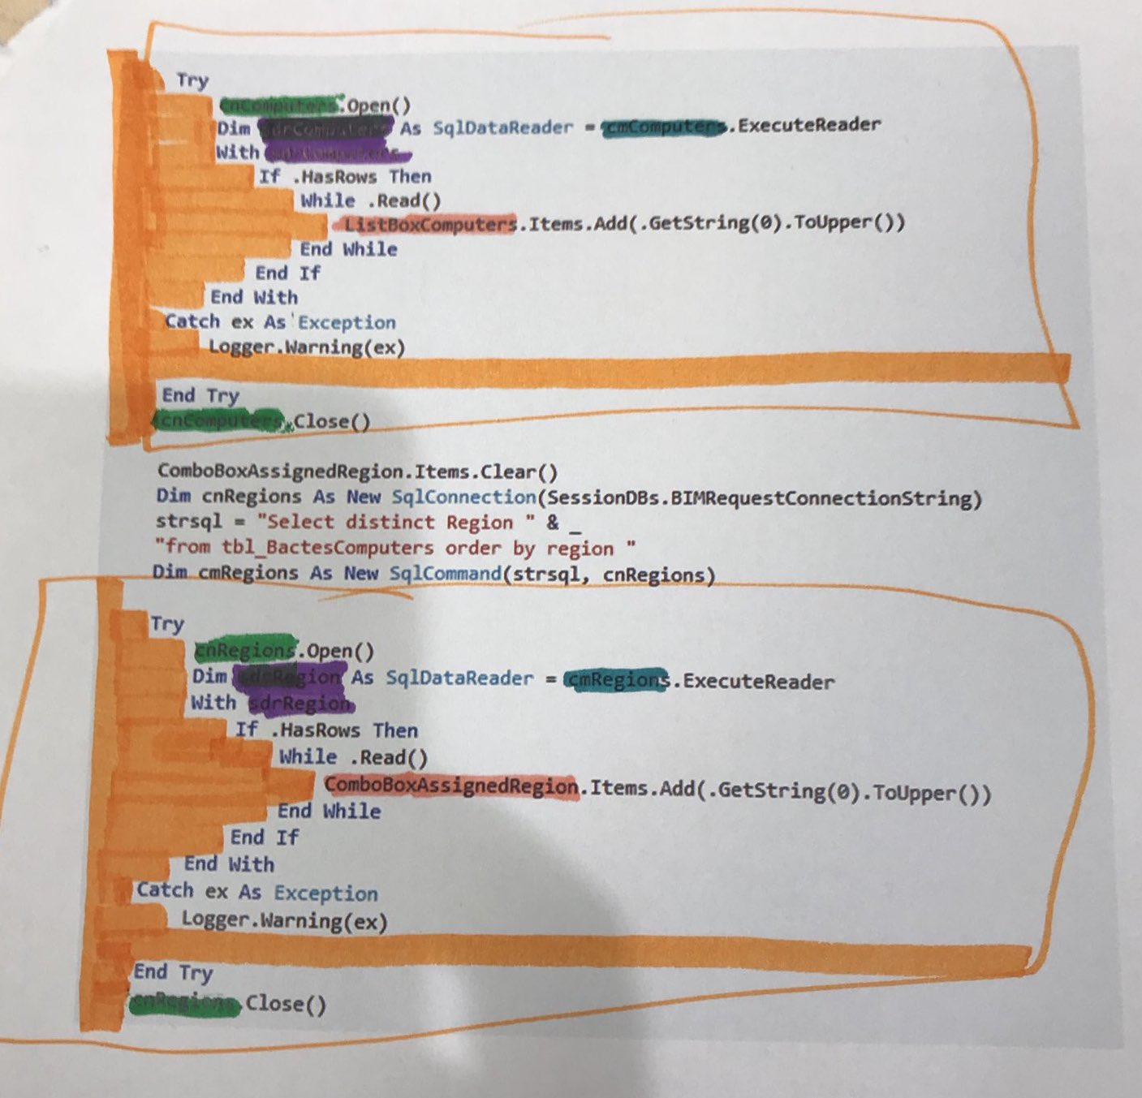
Step 2
Recipe for
Removal

Slide 7

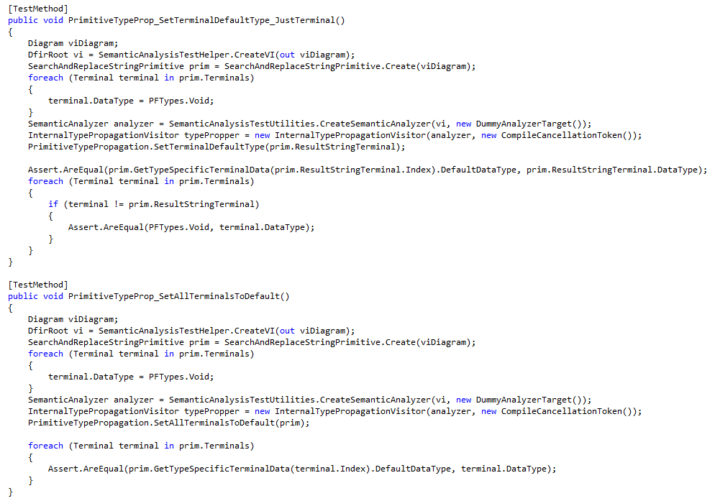
Step 1:
Draw a Box Around the Duplication

Slide 8
Step 1:
Draw a Box Around the Duplication

Slide 9
Step 1:
Color In The Whitespace

Slide 10
Step 1:
Color In The Whitespace

Slide 11
Step 1:
Color In Differences

Slide 12
Step 1:
Color In Differences

Slide 13
Step 1:
Color In Differences

Slide 14
Step 1:
Color In Differences

Slide 15
Step 1:
Color In Differences

Slide 16
Draw a box around the duplication
Fill in the whitespace
Fill in each section that is different (1 color per difference)
Steps

Slide 17
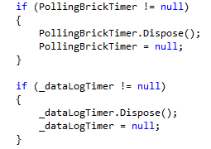
#1

Slide 18
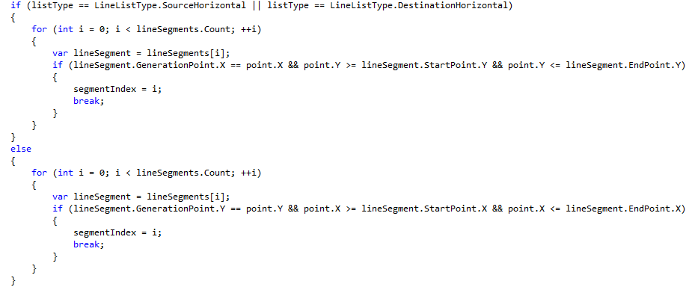
#2

Slide 19
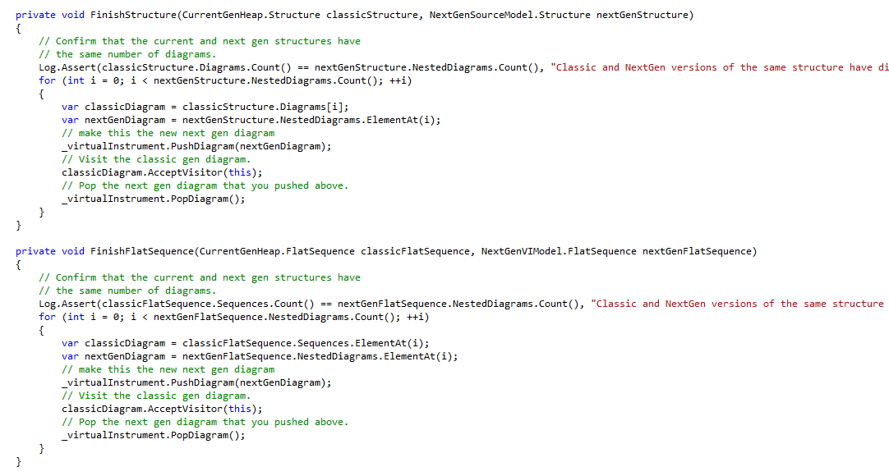
#3

Slide 20
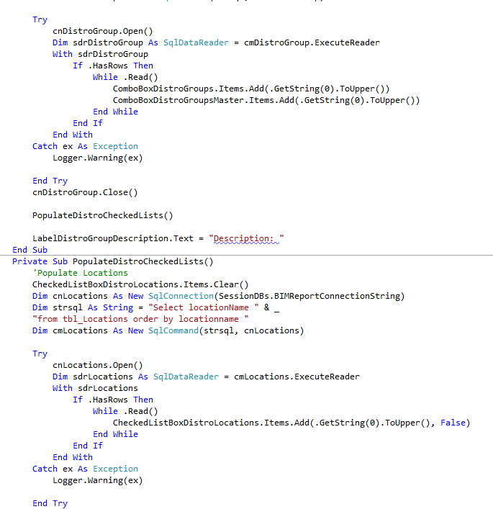
#4

Slide 21
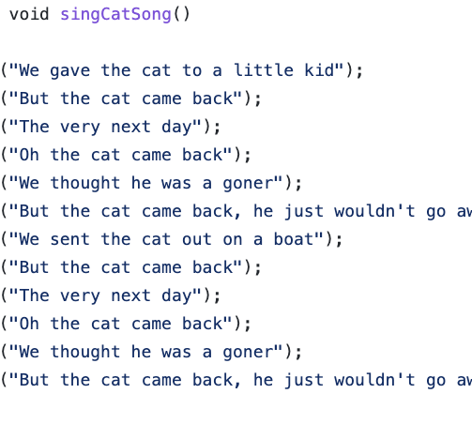
Step 3
Code

Slide 22
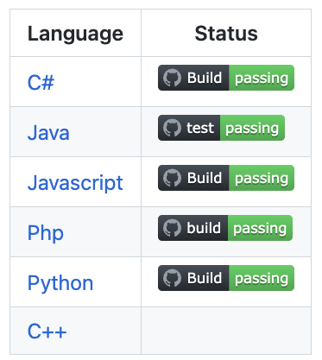
github.com/LearnWithLlew/DuplicationColoringBook

Slide 23
Lesson1Straight
Lesson2Variable
Lesson3HigherOrderFunctions

Slide 24
Drawing Boxes
sing("Hip Hip Horray! For " + name);
sing("Hello " + name + ", it's nice to meet you.");
sing("Say yeah! Say yo! Say " + name);
sing("Hello " + name + ", it's nice to meet you.");

Slide 25
Drawing Boxes = Adding Curly Braces
{
sing("Hip Hip Horray! For " + name);
sing("Hello " + name + ", it's nice to meet you.");
}
{
sing("Say yeah! Say yo! Say " + name);
sing("Hello " + name + ", it's nice to meet you.");
}

Slide 26
Lesson2Variable
Lesson3HigherOrderFunctions

Slide 27
Coloring in Differences
{
sing("Hip Hip Horray! For " + name);
sing("Hello " + name + ", it's nice to meet you.");
}
{
sing("Say yeah! Say yo! Say " + name);
sing("Hello " + name + ", it's nice to meet you.");
}

Slide 28
Coloring in Differences = Extract Variable
{
var blue = "Hip Hip Horray! For ";
sing(blue + name);
sing("Hello " + name + ", it's nice to meet you.");
}
{
var blue = "Say yeah! Say yo! Say ";
sing(blue + name);
sing("Hello " + name + ", it's nice to meet you.");
}

Slide 29
Lesson3HigherOrderFunctions

Slide 30
Introduce Lambda
singLoud("Hello);

Slide 31
Introduce Lambda
((Runnable)( () -> singLoud("Hello"))).run();

Slide 32
Introduce Lambda
Runnable blue = () -> doNothing();
blue.run();

Slide 33
https://github.com/isidore/Talks/blob/master/DuplicationColoringBook.md#duplication-coloring-book

Slide 34
MINIMALIST AESTHETIC PRESENTATION
2022

Slide 35
Google Slides
Click on the "Google Slides" button below this presentation preview. Click on "Make a copy." Start editing your presentation. You need to sign in to your Google account.
How to
Use This Presentation
Canva
Click on the "Canva" button under this presentation preview. Start editing your presentation. You need to sign in to your Canva account.
PowerPoint
Click on the "PowerPoint" button below this presentation preview.
Start editing your presentation. Download and install the fonts used in this presentation as listed on the next page.

Slide 36
Table Of Contents
About Us
Our Projects
Stats & Numbers
Briefly elaborate
on what you want
to discuss.
Briefly elaborate
on what you want
to discuss.
Briefly elaborate
on what you want
to discuss.

Slide 37
01.
ABOUT US
Briefly elaborate on what you want
to discuss.

Slide 38
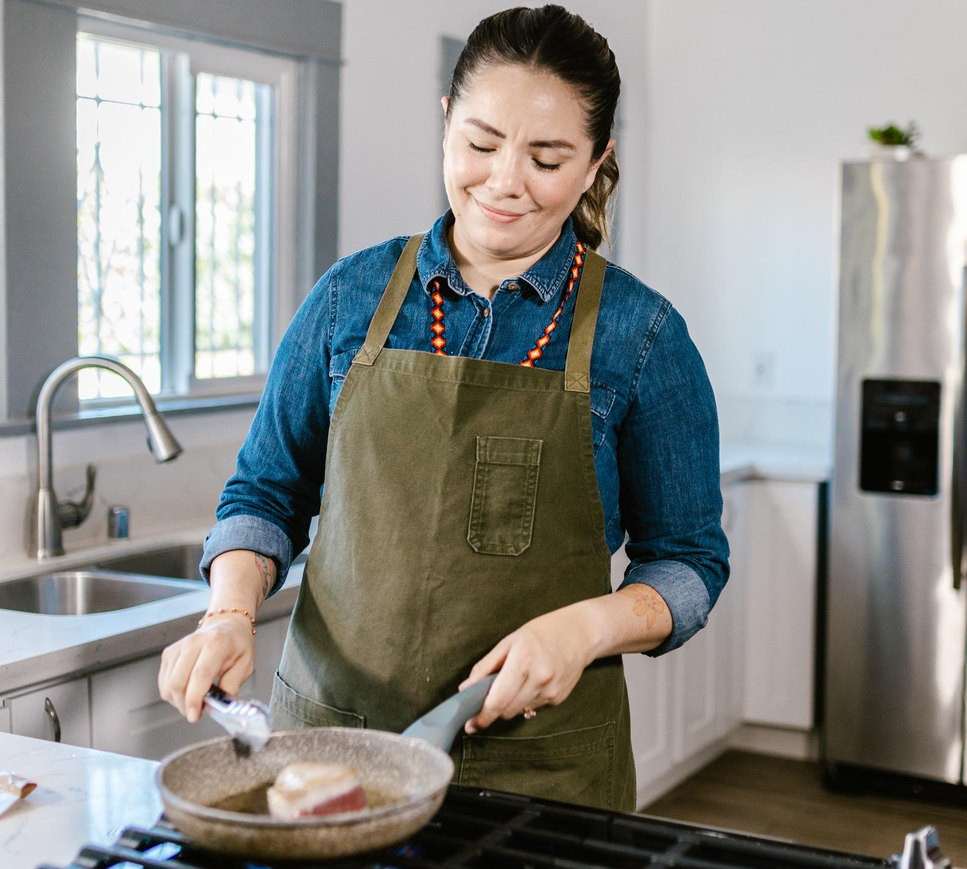
Welcome To Presentation
I'm Rain, and I'll be sharing with you my beautiful ideas. Follow me at @reallygreatsite to learn more.

Slide 39
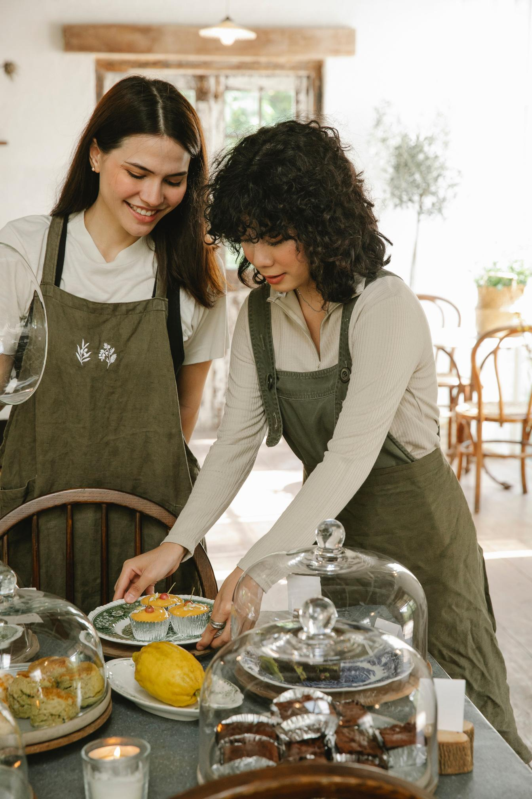
About Us
Who we are?
Briefly elaborate on what you want to discuss.
What we do?
Briefly elaborate on what you want to discuss.

Slide 40
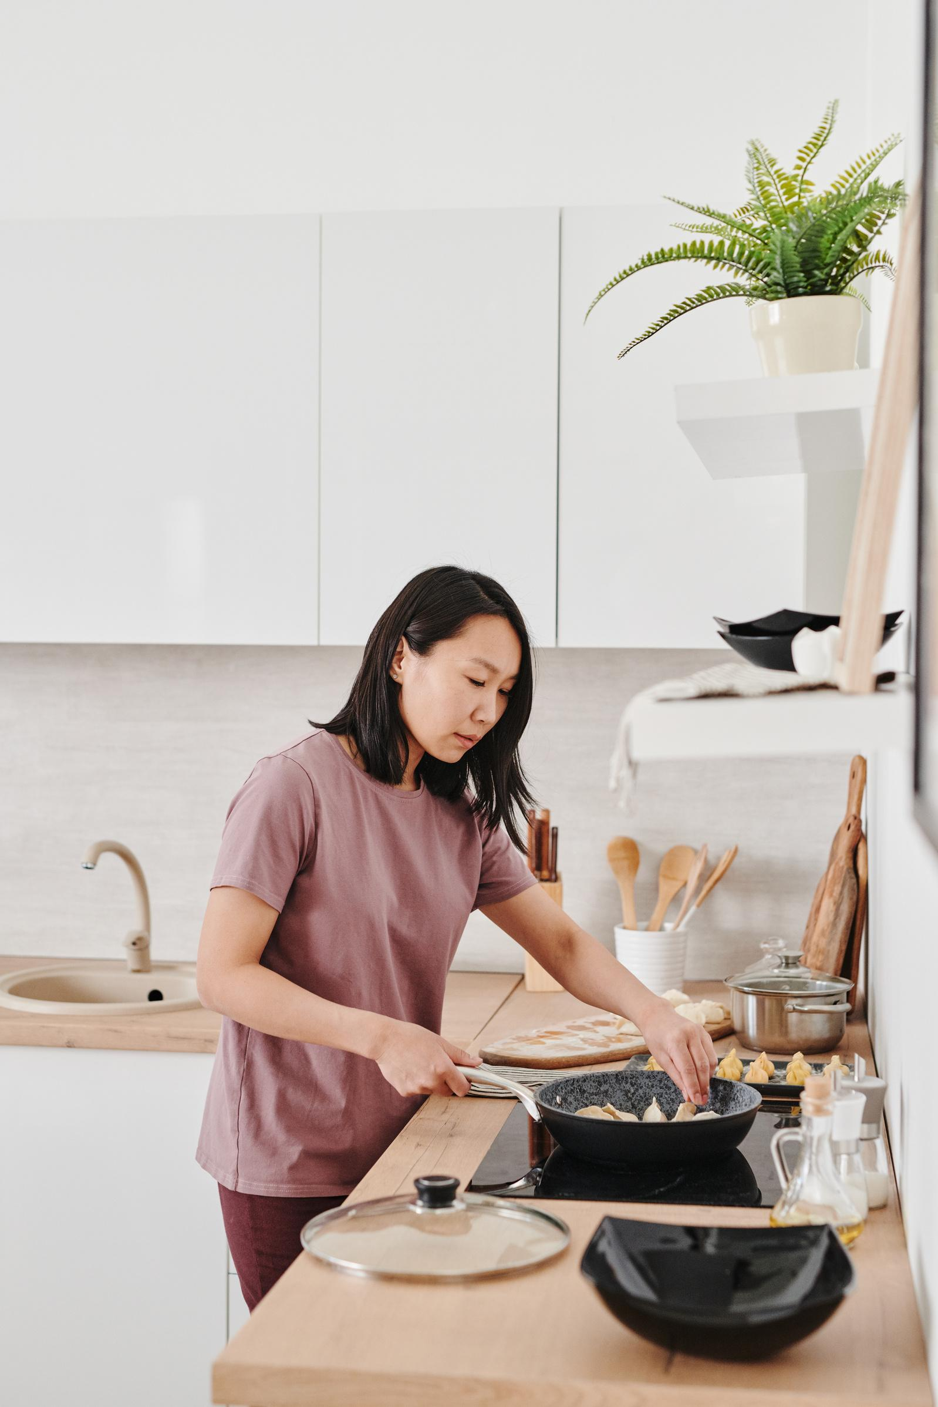
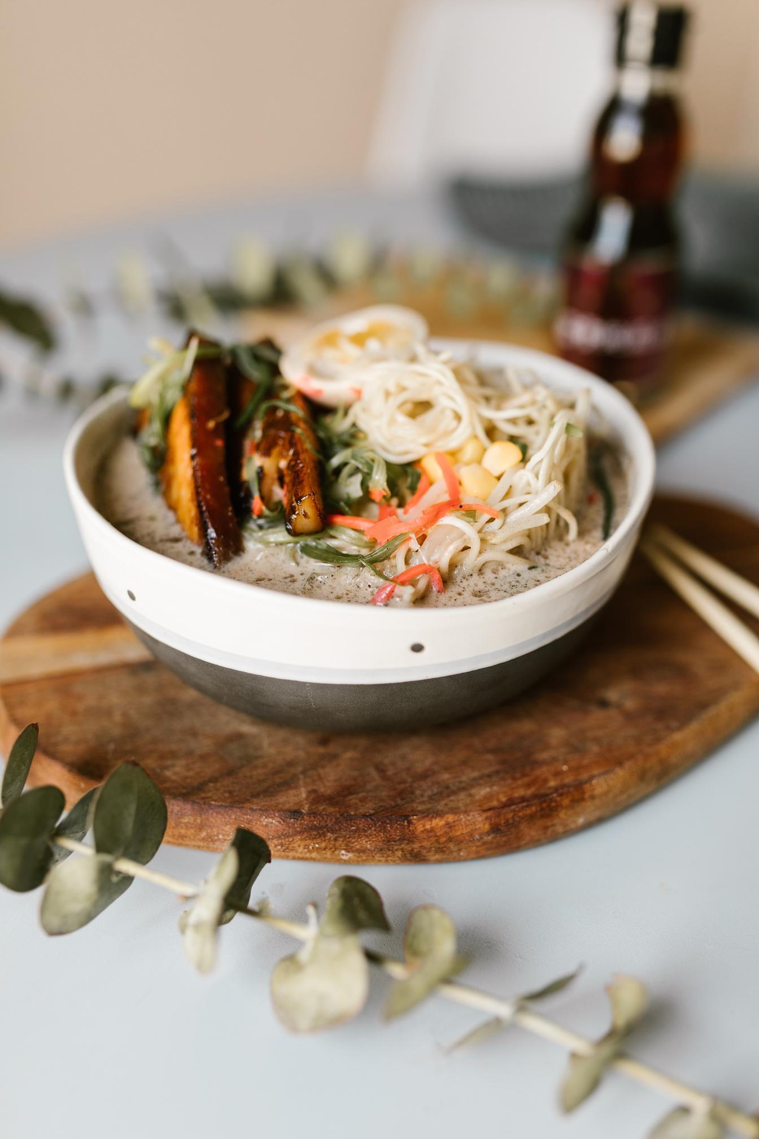
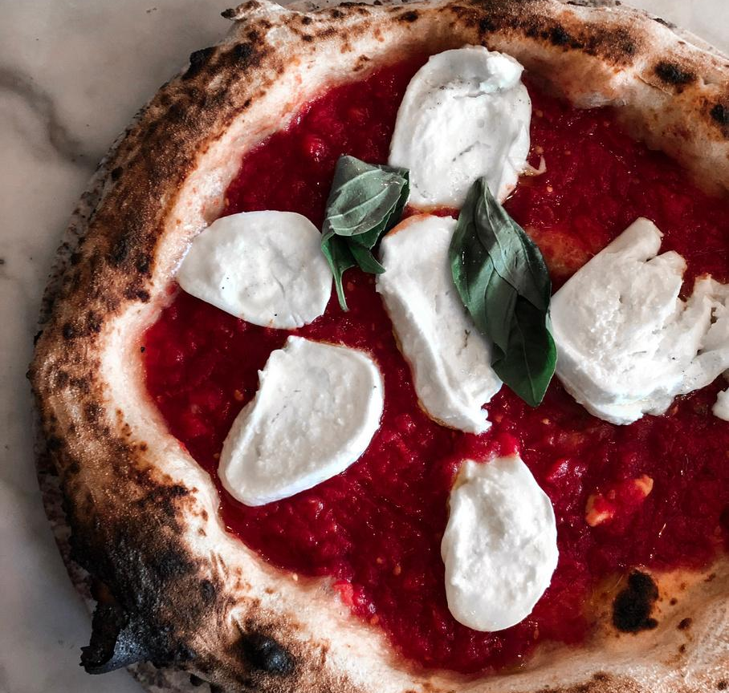
Gallery Image
What can you say about your projects?
Share it here!

Slide 41
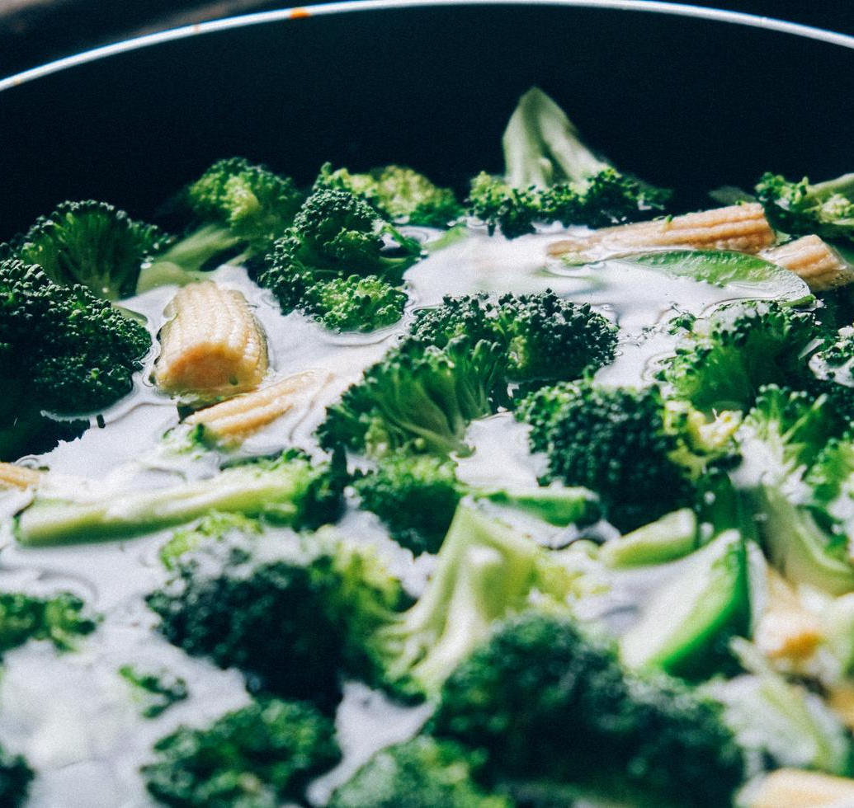
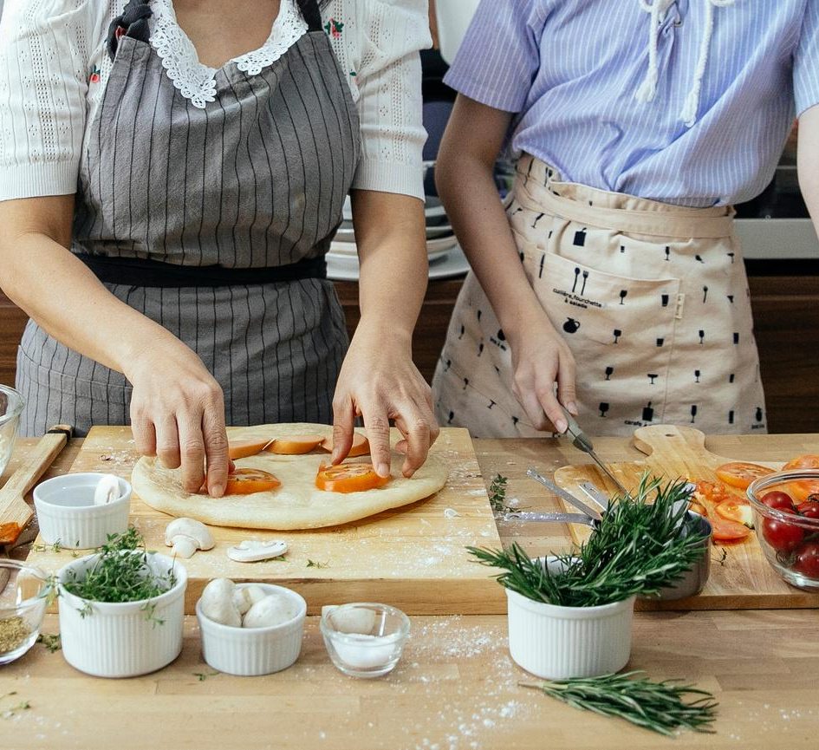
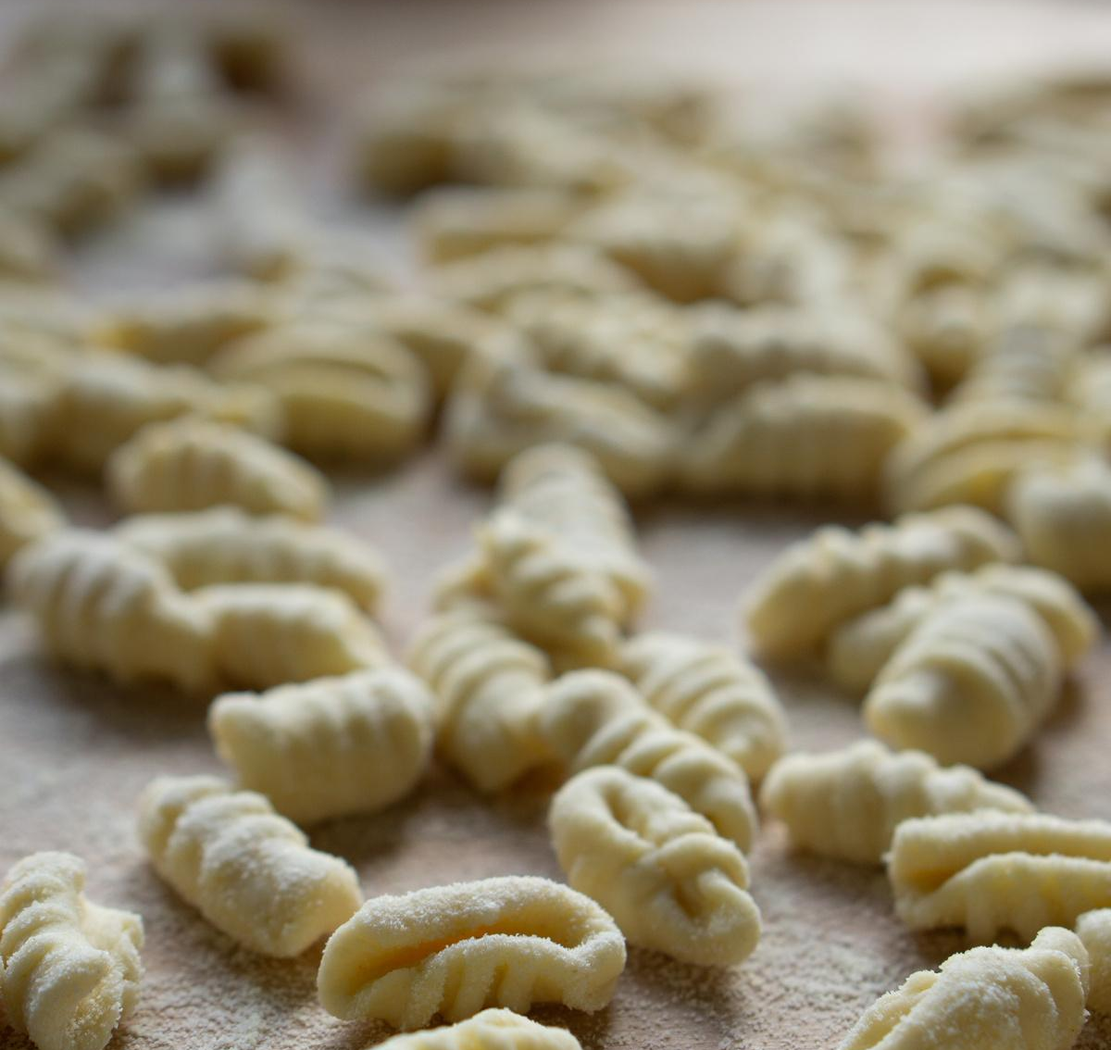
Write Your Idea
Add a main point
Add a main point
Add a main point
Briefly elaborate on what you want to discuss.
Briefly elaborate on what you want to discuss.
Briefly elaborate on what you want to discuss.

Slide 42

Write an original
statement or
inspiring quote
— Include a credit, citation, or supporting message

Slide 43



Meet Our Team
Name Surname
Name Surname
Name Surname
Title
Title
Title

Slide 44



Testimonials
Client name
Client name
Client name
Elaborate on what you want to discuss.
Elaborate on what you want to discuss.
Elaborate on what you want to discuss.

Slide 45
02.
OUR PROJECTS
Briefly elaborate on what you want
to discuss.

Slide 46
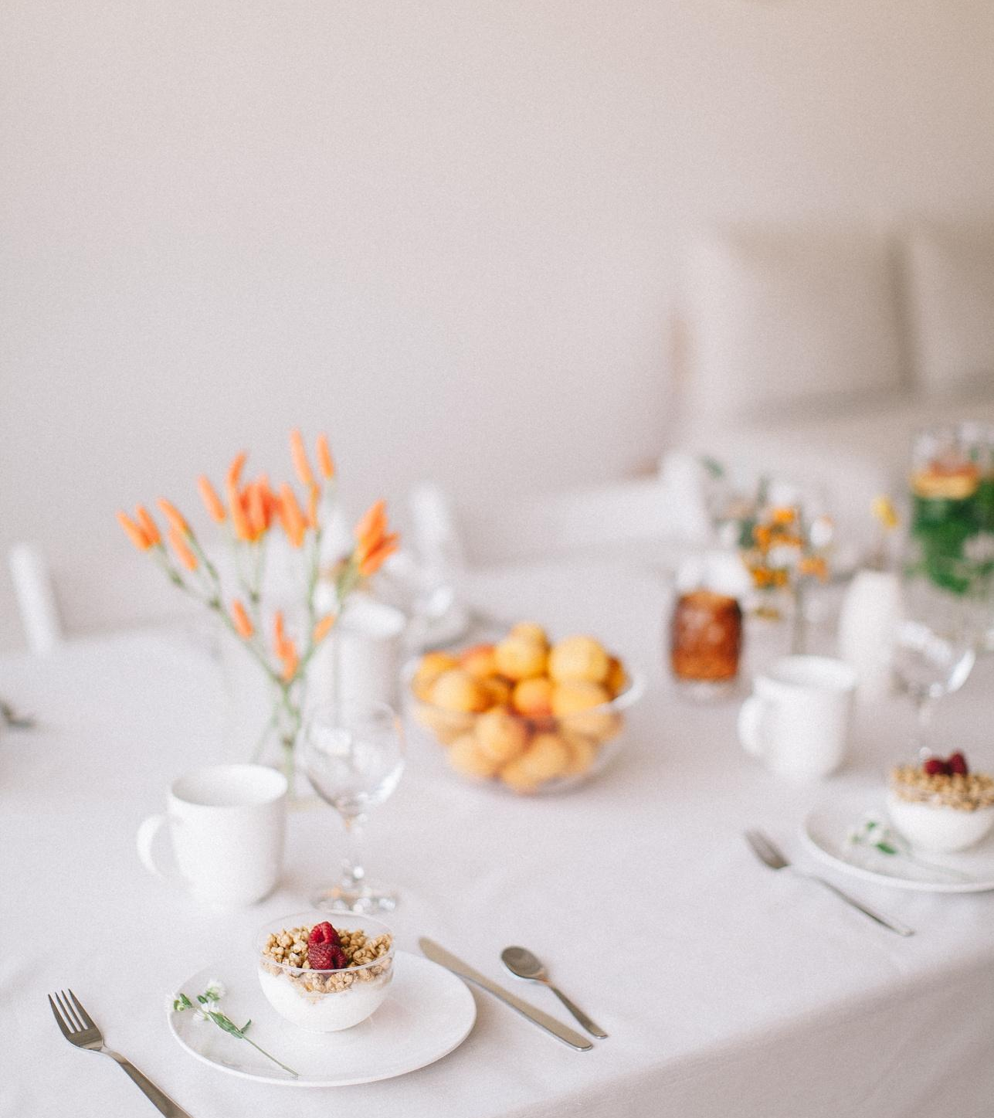
Your Project
Presentations are communication tools that can be used as demonstrations, lectures, speeches, reports, and more. It is mostly presented before an audience. It serves a variety of purposes, making presentations powerful tools for convincing and teaching.
YEAR: 2022
ROLE: WRITE YOUR ROLE

Slide 47
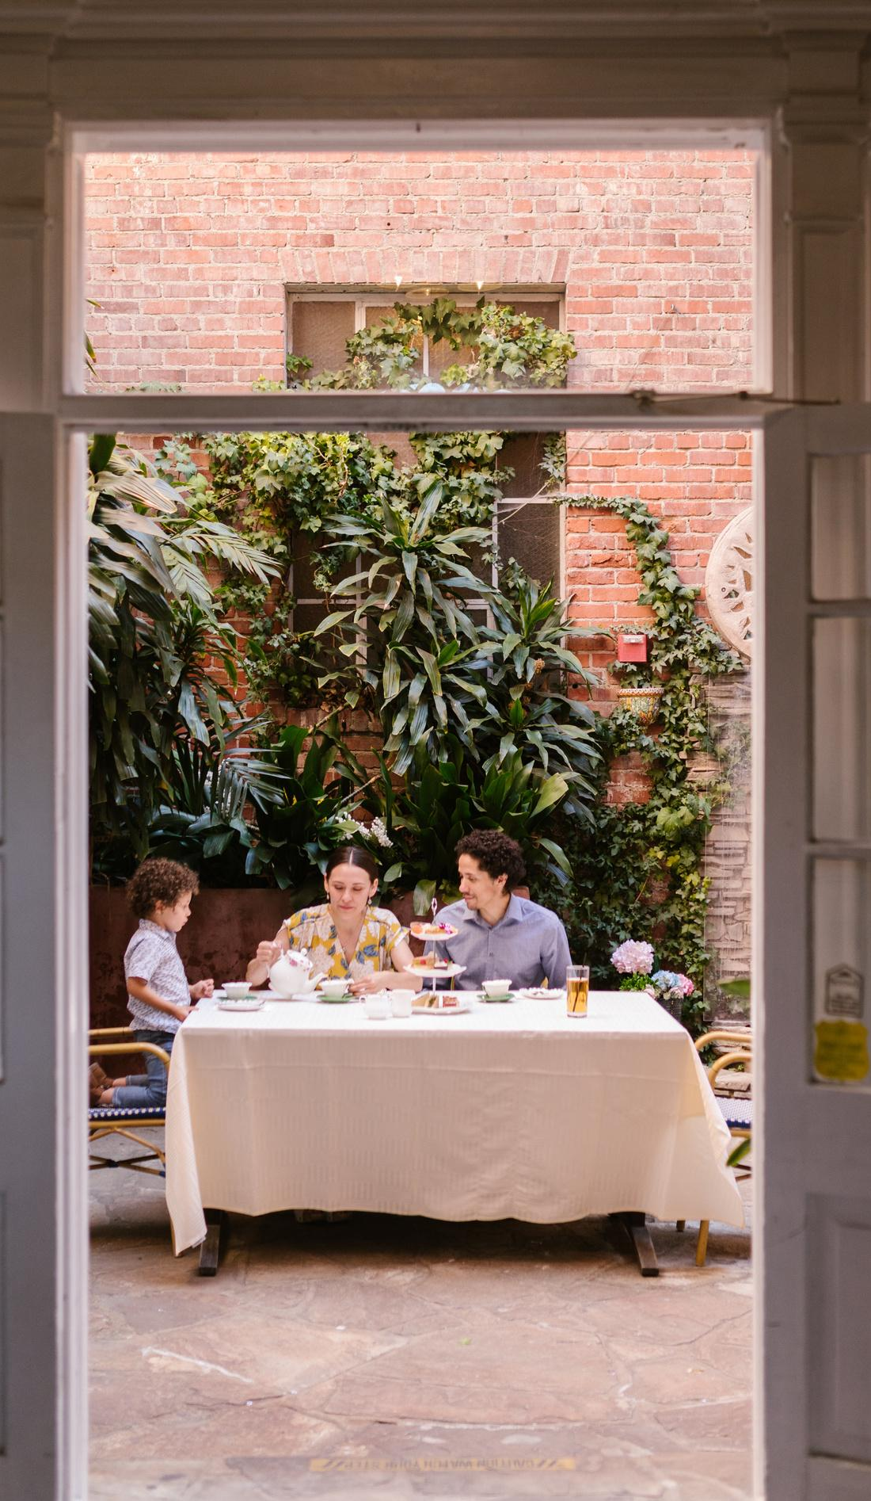
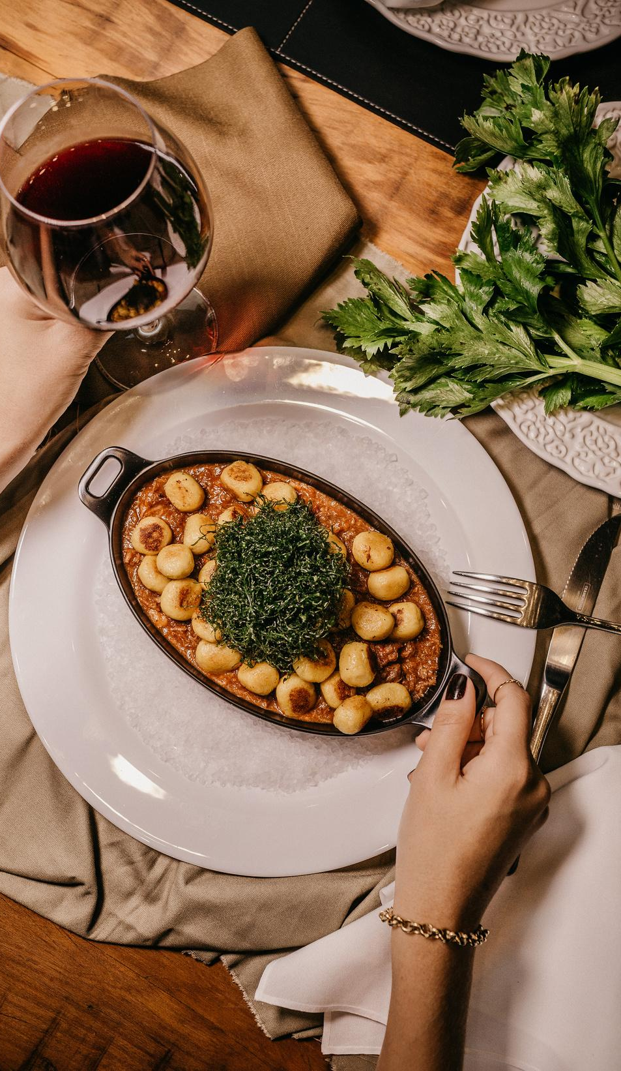
A picture is worth a thousand words
What can you say about your projects?
Share it here!

Slide 48
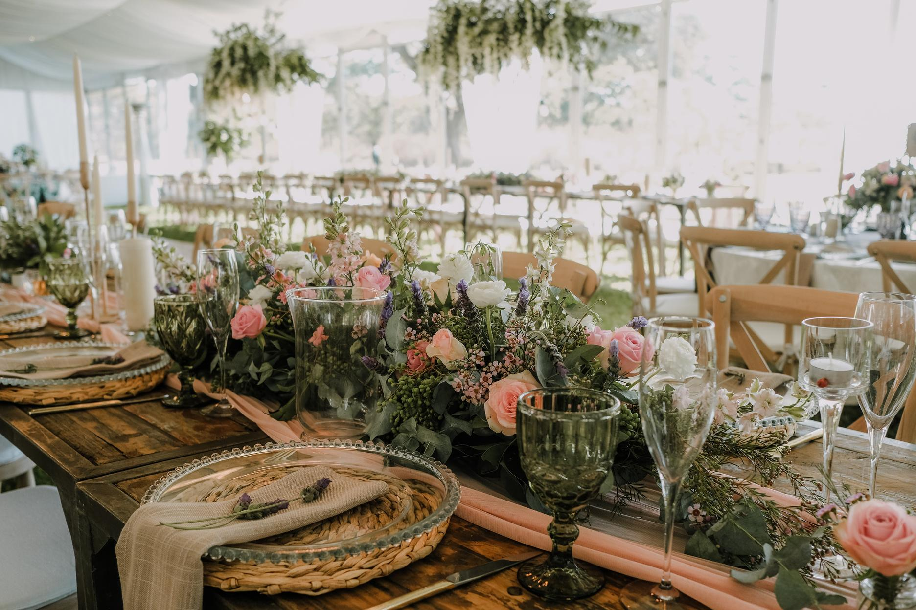
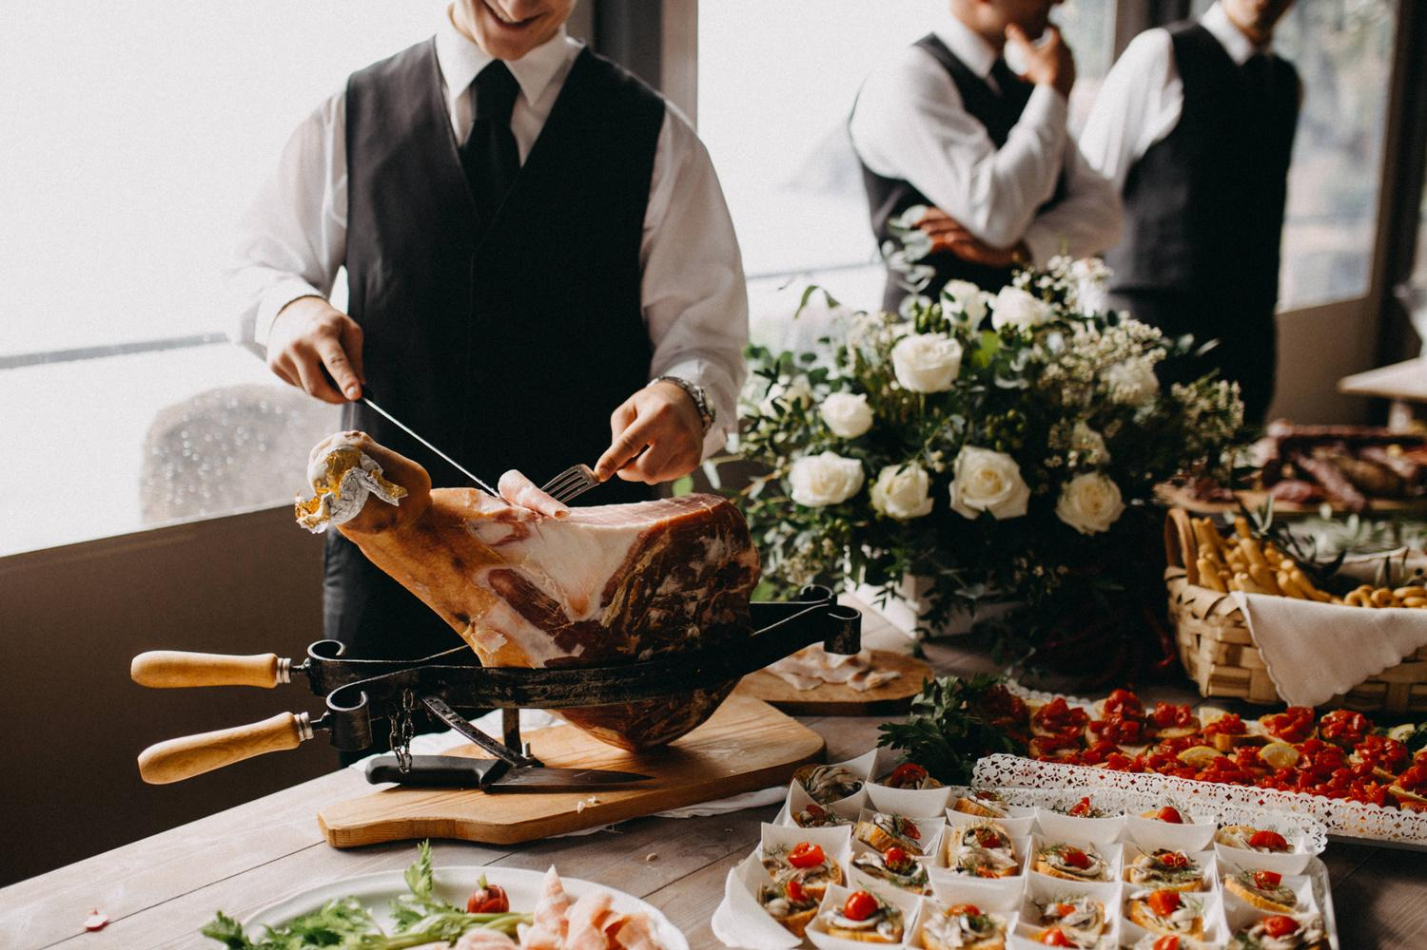
Our Services
01
02
03
Add a main point
Add a main point
Add a main point
Elaborate on what you want
to discuss.
Elaborate on what you want
to discuss.
Elaborate on what you want
to discuss.

Slide 49

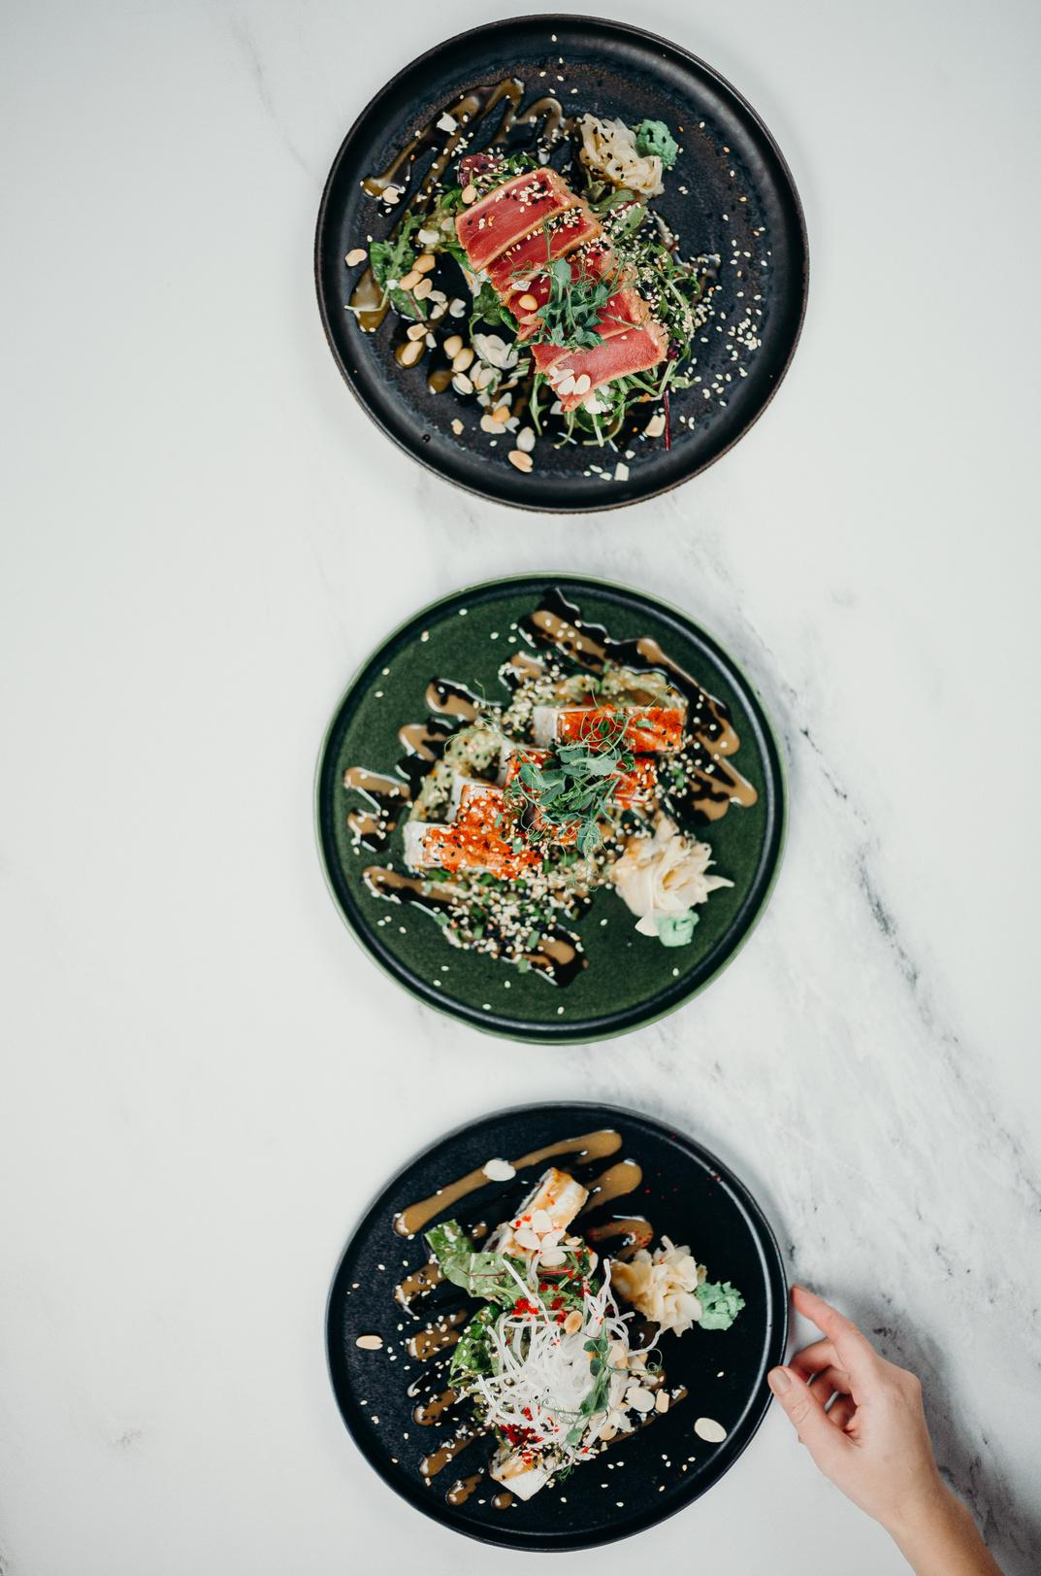
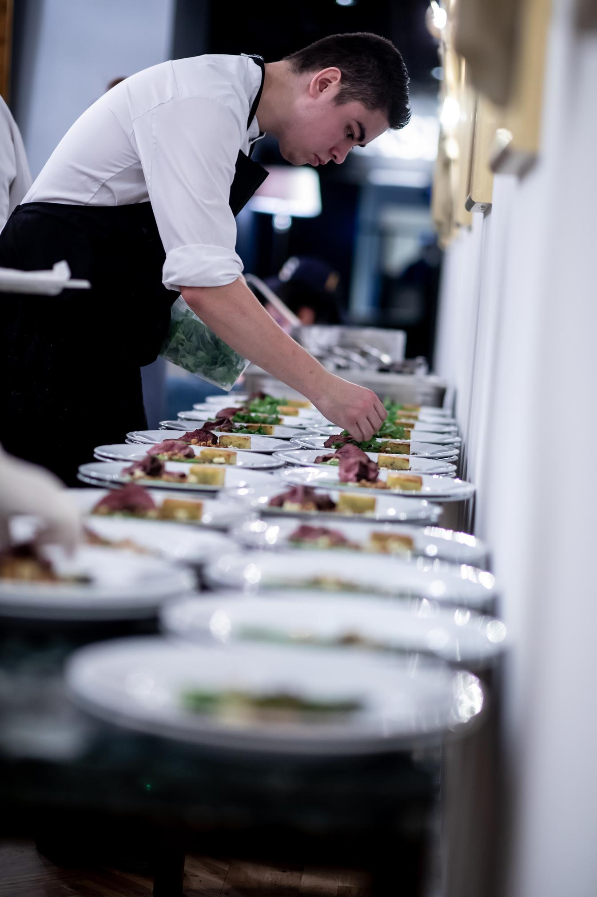
Phone
Mockup
What can you say about your projects?
Share it here!

Slide 50
03.
STATS & NUMBERS
Briefly elaborate on what you want
to discuss.

Slide 51
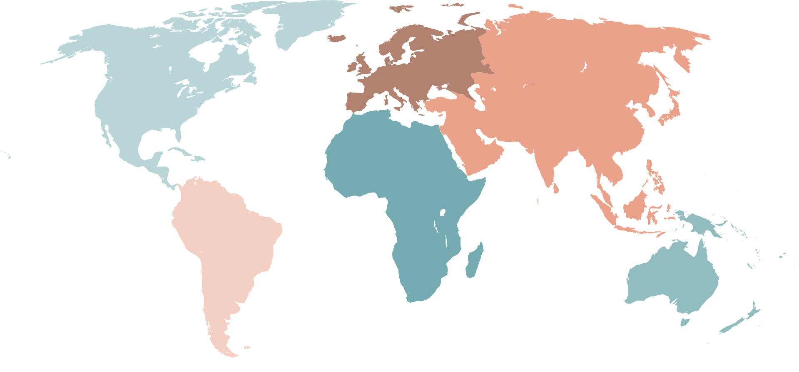
World Map Report
Step One
Step Two
Presentations are
communication tools
Presentations are
communication tools
Step Three
Step Four
Presentations are
communication tools
Presentations are
communication tools

Slide 52
50
40
Write Your
Topic or Idea
30
20
Elaborate on the featured statistic.
10
0
Item 1
Item 2
Item 3
Item 4
Item 5

Slide 53
Add a Pricing Page
20$
30$
300$
MONTHLY
MONTHLY
YEARLY
Add a feature
Add a feature
Add a feature
Add a feature
Add a feature
Add a feature
Add a feature
Add a feature
Add a feature
Add a feature
Add a feature

Slide 54
RESOURCE
PAGE
Use these design resources in your Canva Presentation.
Happy designing!
Don't forget to delete this page
before presenting.

Slide 55
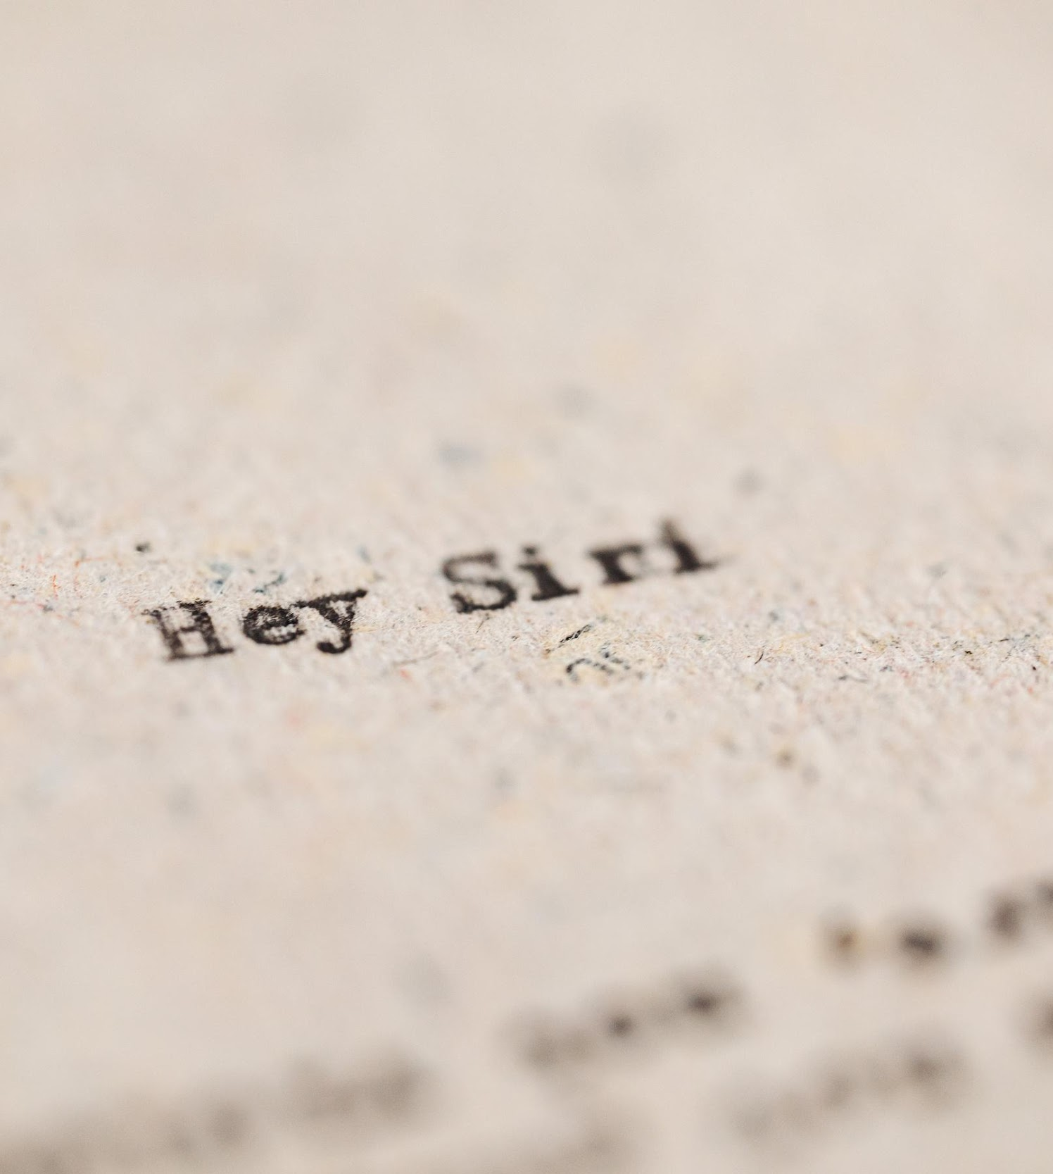
Fonts In this Presentation
This presentation template uses the following free fonts:
Titles: Nunito Light
Headers: Nunito Sans Black
Body Copy: Nunito Light

Slide 56
Credits
This presentation template is free for everyone to use thanks to the following:
SlidesCarnival for the presentation template
Pexels for the photos
Happy designing!

Slide 57

Free templates for all your presentation needs
For PowerPoint, Google Slides, and Canva
100% free for personal or commercial use
Ready to use, professional, and customizable
Blow your audience away with attractive visuals

